Slide 1



Workshop Day 2: SIMROUTE® Marine environmental module: methodology and calculation of Ship Emissions
Debriefing
Chalmers University of Technology
April 6th, 2022

Slide 2
WSR software deals some specific topics (marine environment, safety of navigation, ships routing, meteorology and navigation equipment) that are part of syllabus of Maritime Education Training (MET) institutions’ programs and in STCW 95/2010 Code (STCW 2011).
Inventory of which of these WSR topics are part of the knowledge (Column 2 of part A: competences tables of STCW Code) of these competences.

Slide 3
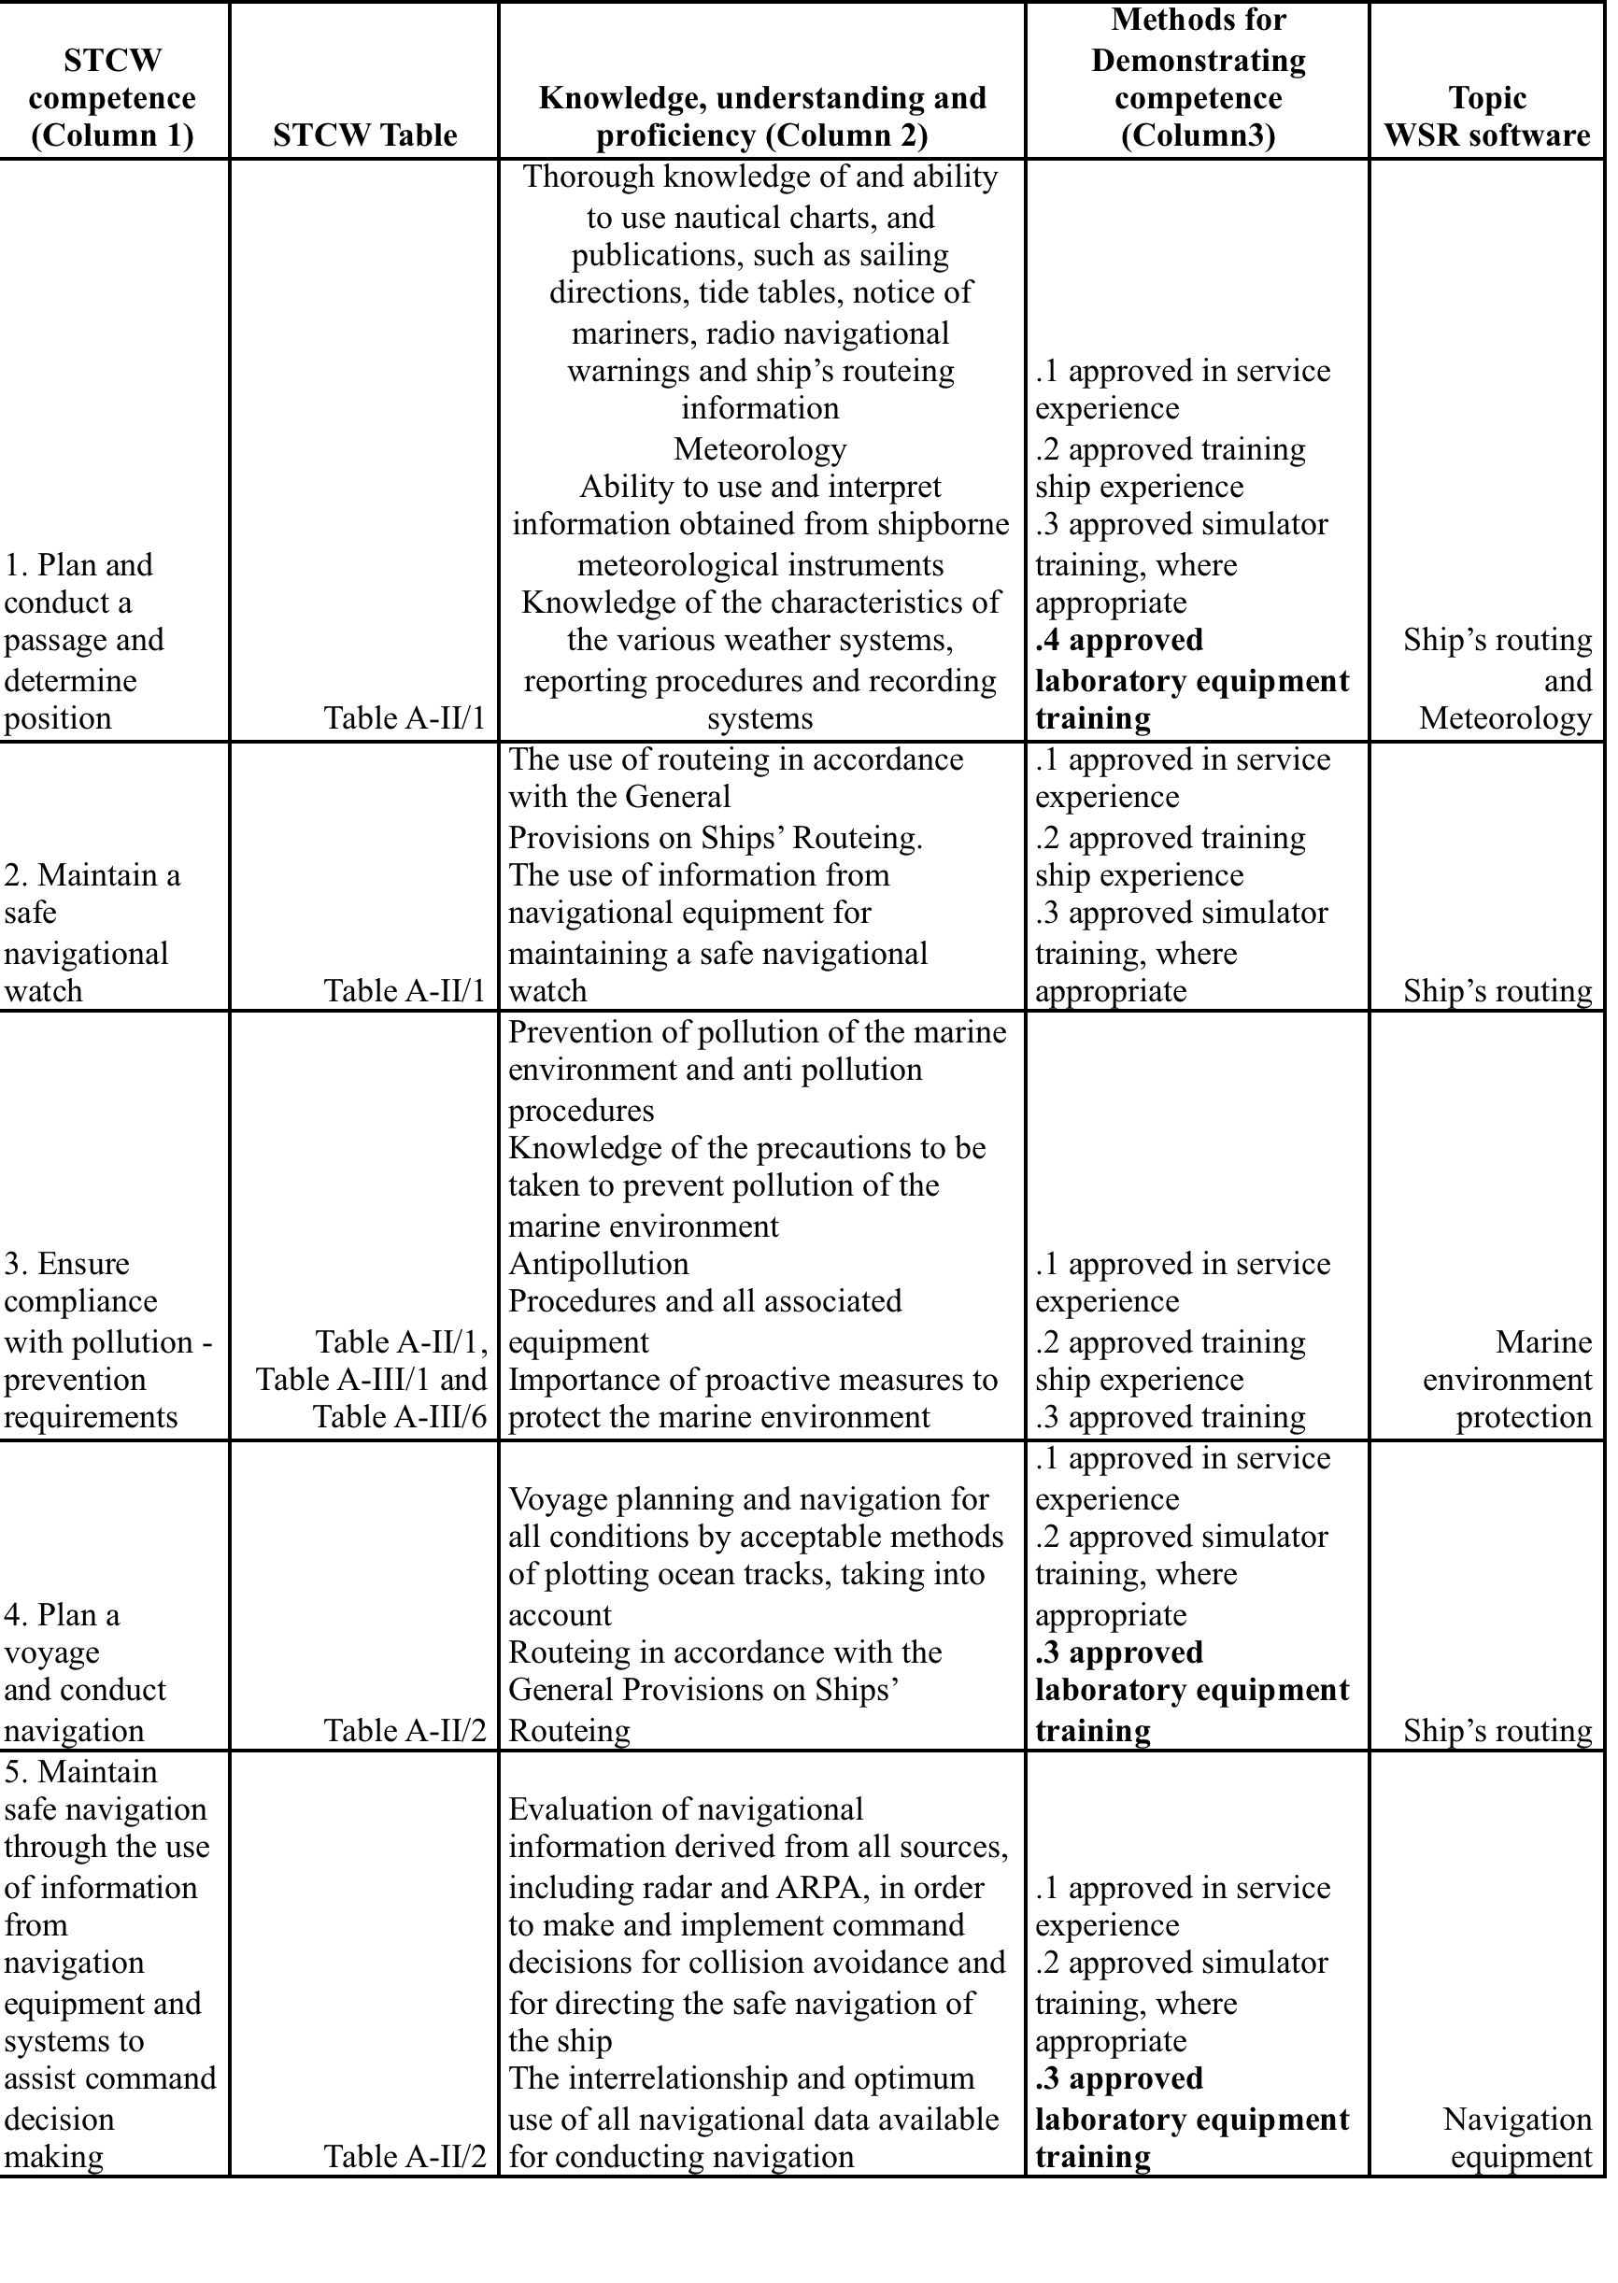

Slide 4
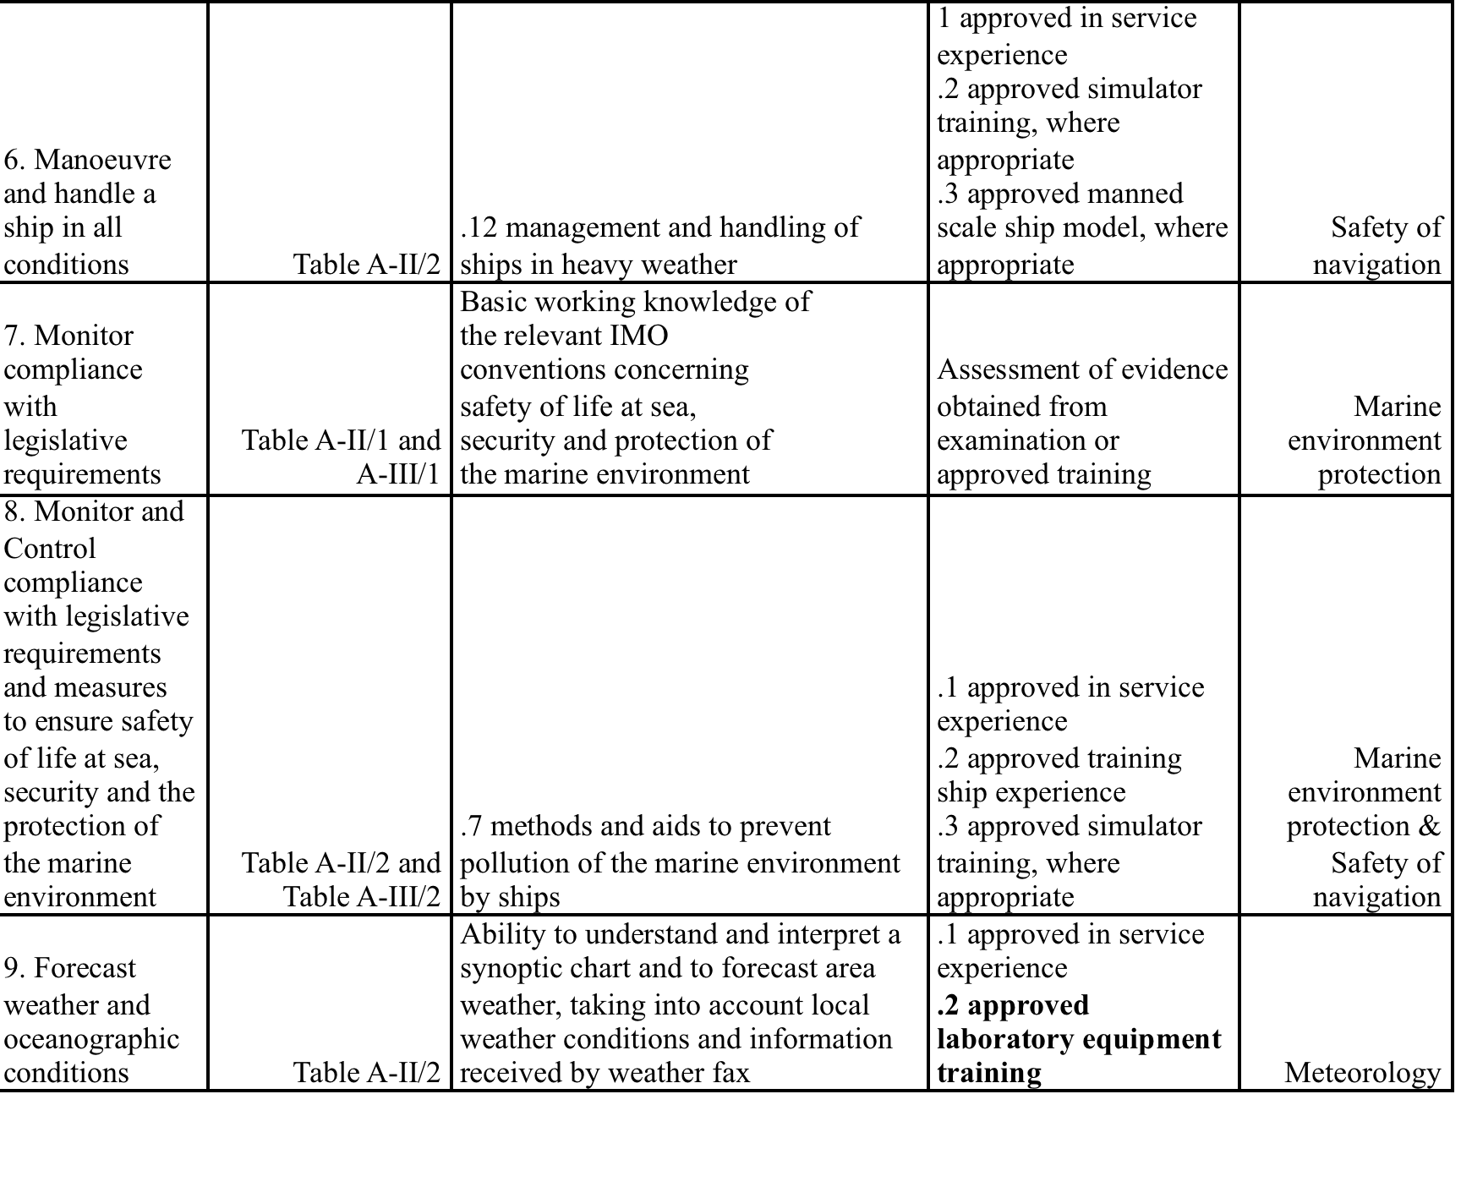

Slide 5
STCW competences
We want to know if knowledge of competences out of all the ones described in column 1 of Tables A-II/1, A-II/2, A-III/1, A-III/2 and A-III/6 of STCW may be evaluated using proposed WSR software.
Most of the knowledge is from master and deck department competences and only competences 3, 7 and 8 from former table have the same knowledge for deck and engine departments.

Slide 6
STCW competences
WSR software training should be included in the approved laboratory equipment training and only competences 1, 4, 5 and 9 may be evaluated with WSR software.
Nevertheless Marine environment protection module could be introduced to reinforce this specific knowledge.

Slide 7
Debriefing Test
https://forms.gle/BtPBHSVUQTucFXck7

